Slide 1

Sports Analytics Contest
By Evan scheibler

Slide 2
Goals of research
Find likelihood of season ticket holders to continue to buy next season
Determine key factors in those who will defect and those who won’t
Use data visualization tools to help predict future trends

Slide 3
Data
Chose a few key variables to focus on
Backers: Is the customer a member of the ‘backers’ club
Years: Number of years the customer has been a season ticket holder
Percent Married: Based on zip code, number of married heads of household in the customer’s area
Home Evaluation: Average value of homes in customer’s zip code

Slide 4

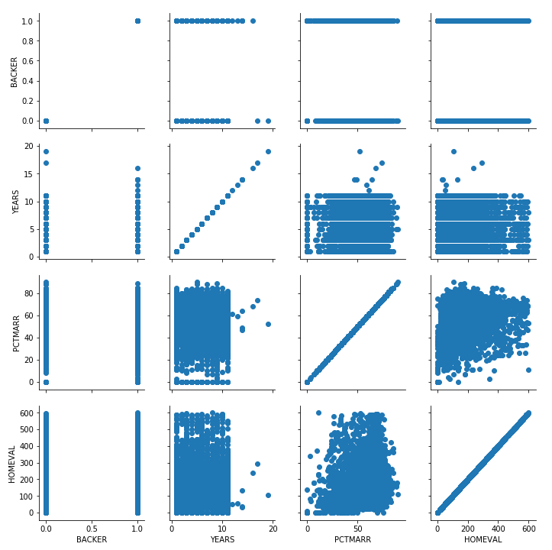
Visualization

Slide 5
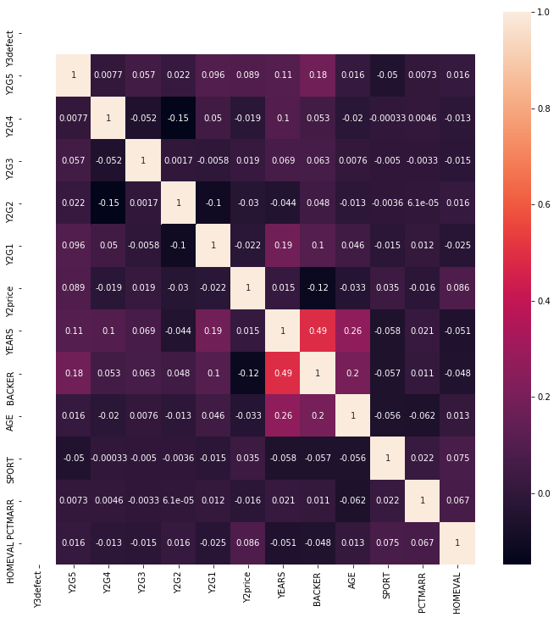
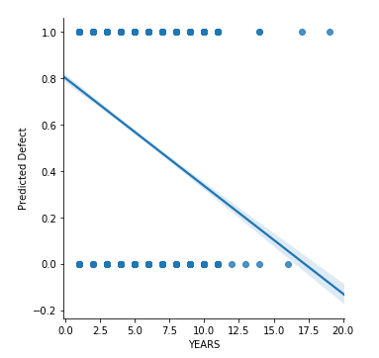
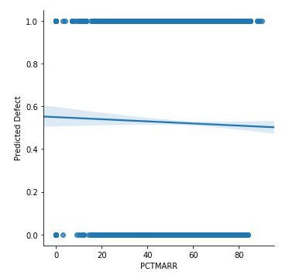
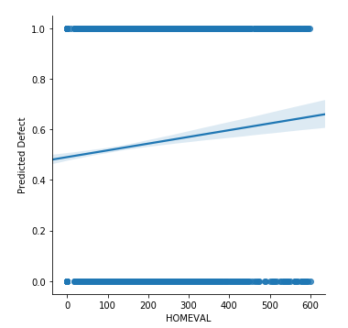
Visualization

Slide 6
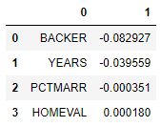
Regression Tests
Mean Square Error = 0.22699313
Variance = .09047677

Slide 7
Conclusions
Married Percentage and Housing Evaluations have little influence on defects/non-defects
‘Backers’ club members are incredibly likely to be season ticket holders, we don’t need to advertise to them
Years have small influence on returning purchases
Advertising to customers through sports magazines may be a valid strategy
Sending flyers/postage to specific zip codes outside of Manhattan could net more potential customers

